Slide 1
Shaquille O'Neal NBA Career
Shiwei Kang, Omkar Jadhav and Sabari Mukundth J

Slide 2
Outline:
Dataset / description
Source
Research questions
Data tidying and transformations
Exploratory visualizations and research questions
Data analysis and associated data visualizations
(Initial) results
Conclusions
Challenges / further analysis

Slide 3
Dataset / description
The dataset appears to contain game-by-game regular season statistics for Shaquille O'Neal's NBA career. The columns include various performance metrics such as points scored (PTS), rebounds (TRB), assists (AST), steals (STL), blocks (BLK), turnovers (TOV), and personal fouls (PF), among others. There are also indicators for the season number, game number, date, age, team, whether the game was at home or away, the opponent team, win/loss, and the point difference in the game.

Slide 4
Source
The dataset is a compilation of Shaquille O'Neal's performance in each game during the NBA regular seasons. It is selected from https://sports-statistics.com/sports-data/sports-data-sets-for-data-modeling-visualization-predictions-machine-learning/

Slide 5
Research Question
#1 Does Shaquille O'Neal's individual game statistics significantly impact his team's chances of winning (Win)?

Slide 6
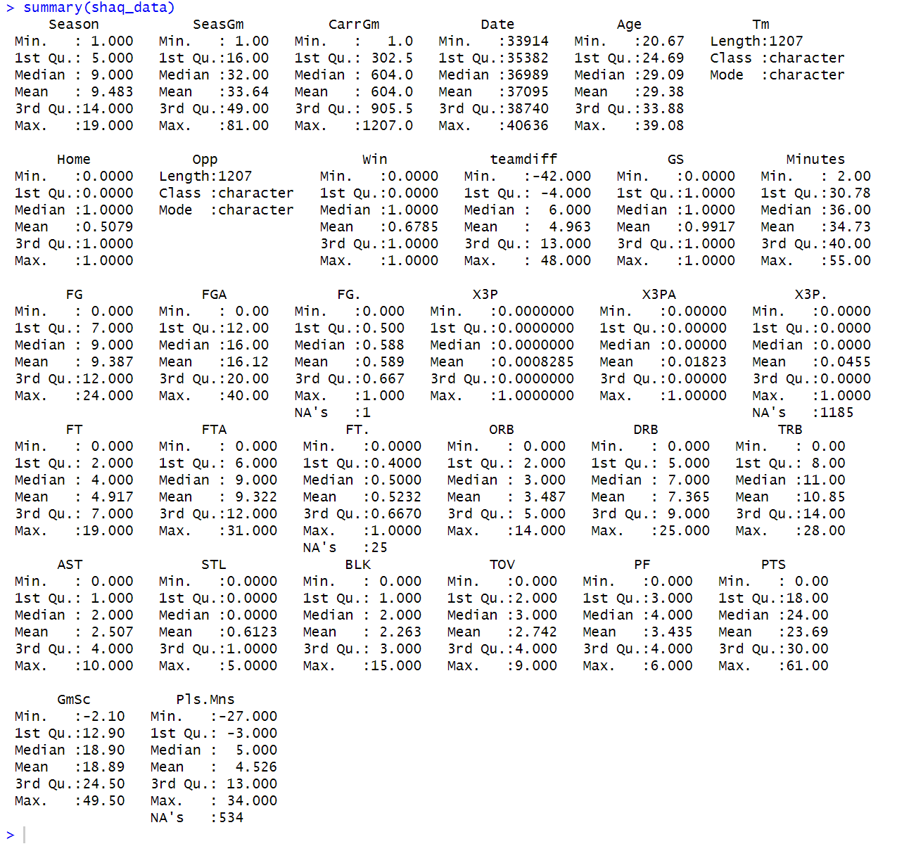
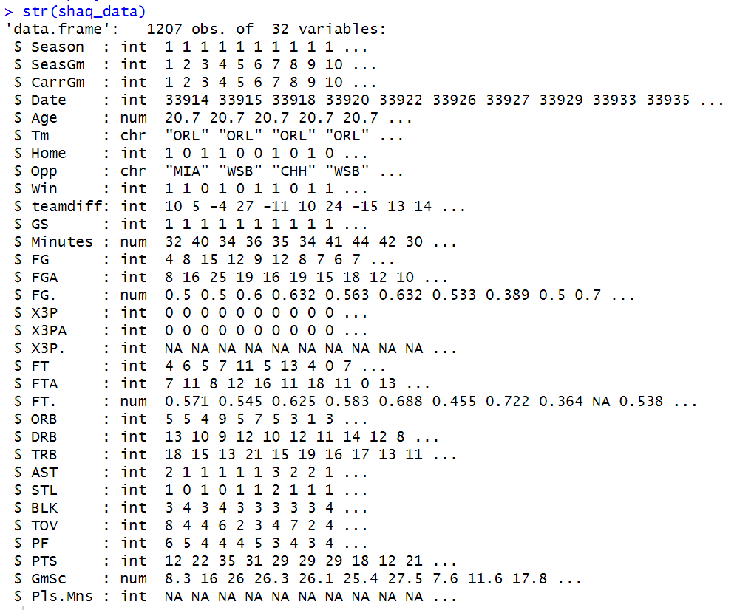
Data tidying and transformations
Upon analyzing the data, I noticed significant null values in metrics like 'X3P.' (Three-Point Field Goals made) and 'Pls.Mns' (Plus/Minus: team point differential with the player on court). Lacking a viable method to handle these nulls, we temporarily retain them.

Slide 7
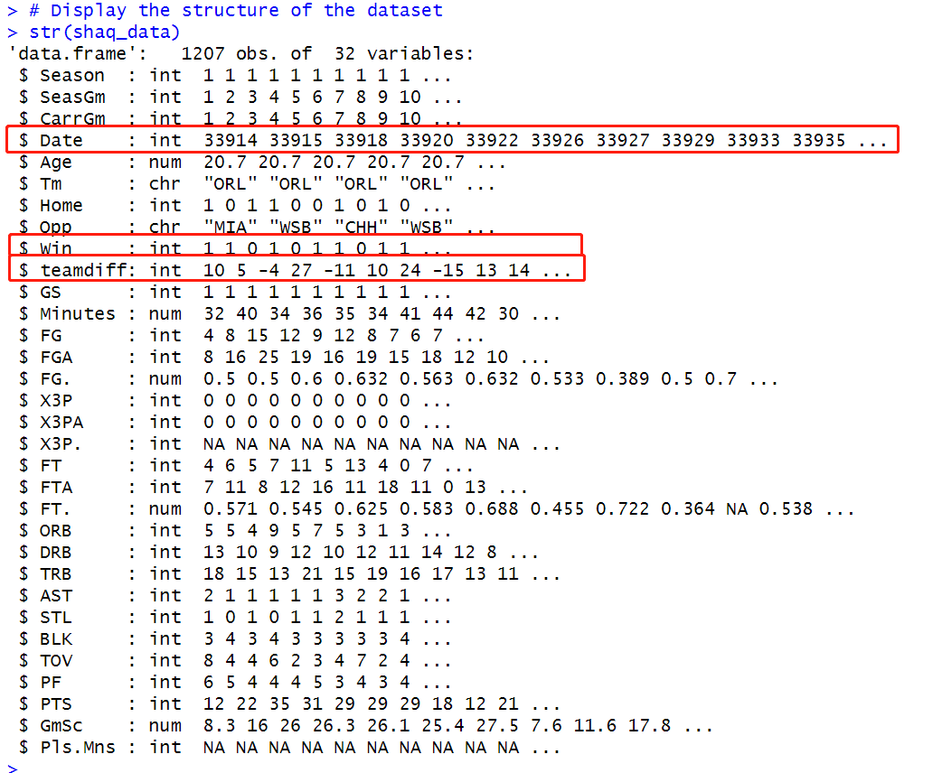
Data tidying and transformations(cont.)
'GameDate' Adjustment:
'Date' variable adjusted and reformatted using as.Date, with a specific origin date.
'Win' Conversion:
Transformed into a factor for logistic regression.
Exclusion of 'teamdiff':
Removed from dataset before classification tree analysis.

Slide 8
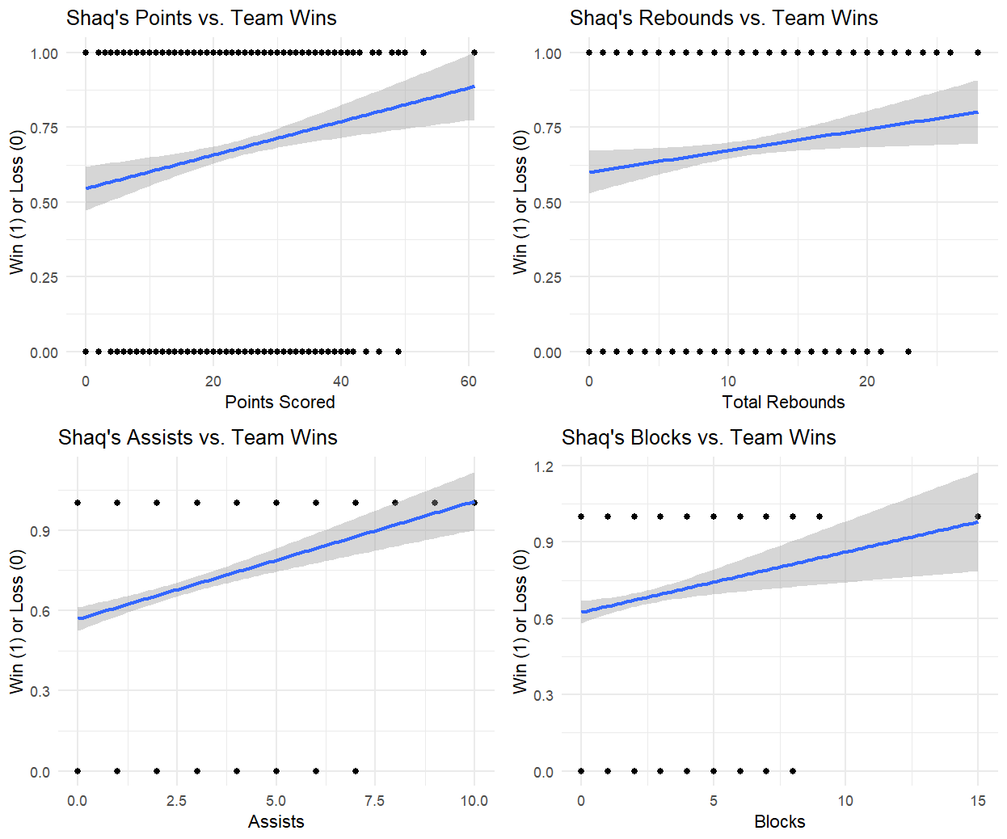
Exploratory visualizations and research questions
Linear Regression Graphs:
Created four graphs showing linear correlations between Shaq's performance metrics (scoring, rebounds, assists, blocks) and team wins/losses. Improved Shaq stats correlate with higher win likelihood.

Slide 9
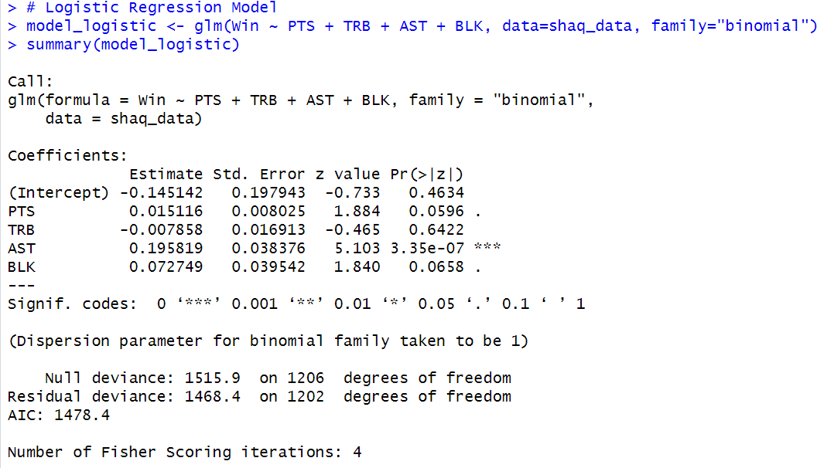
Data analysis and associated data visualizations -Logistic Regression Model
Logistic Regression Model: Used to predict 'Win' with PTS, TRB, AST, and BLK.
Key Findings: Strong correlation between assists and winning; positive but less certain impact of points scored; rebounds and blocks show weaker significance in predicting wins.

Slide 10
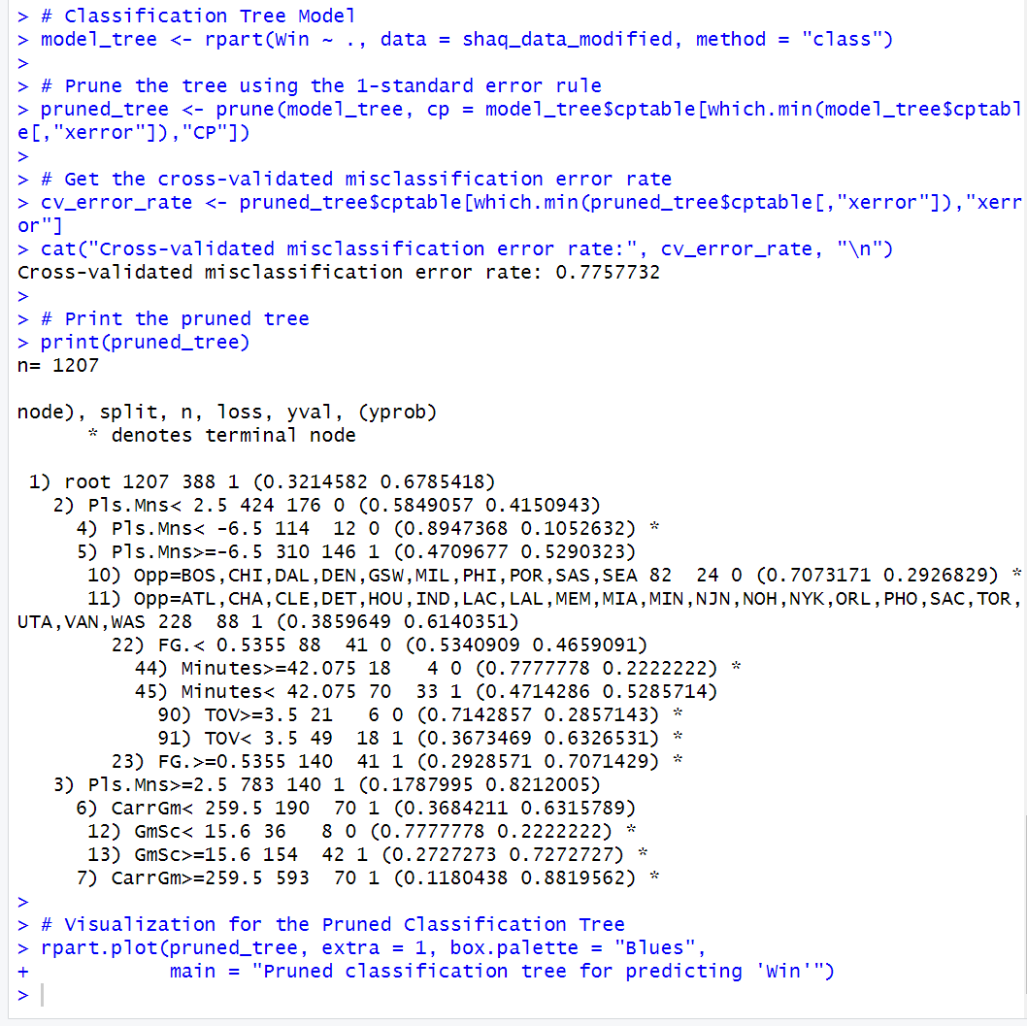
Data analysis and associated data visualizations
-Classification Tree Model
Model Creation: Built a classification tree (model_tree) with 'class' method on the modified shaq_data.
Pruning: Applied 1-standard error rule for model simplification.
Error Rate: Pruned tree's error rate is 77.58%, indicating prediction accuracy.

Slide 11
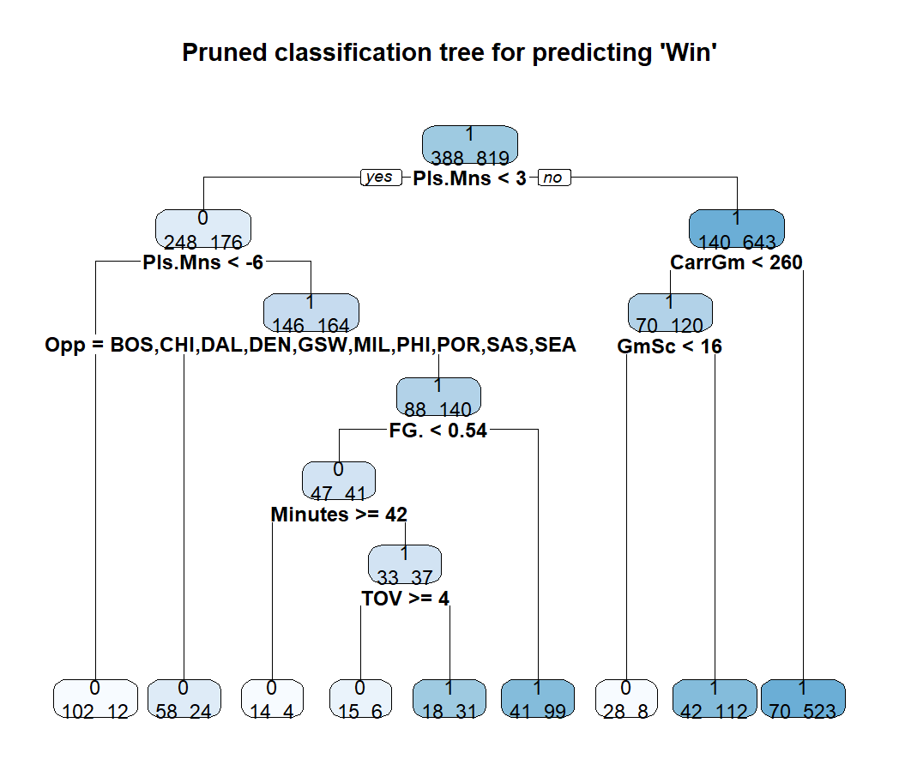
Data analysis and associated data visualizations
-Classification Tree Model(cont.)
Root Node: Represents 1207 observations, with 'Win' distribution of 0.3215 for '0' and 0.6785 for '1'.
Splits: Tree divides based on 'Pls.Mns', 'Opp', 'FG.', 'Minutes', 'TOV', 'CarrGm', 'GmSc'.
Terminal Nodes: For instance, node 4 predicts 'Win' as '0' with 0.8947 probability when 'Pls.Mns' < -6.5.
Visualization: Used rpart.plot for clear representation of the pruned tree.

Slide 12
(Initial) results
Logistic Regression Model:
Predicts 'Win' using PTS, TRB, AST, BLK.
AST and BLK have positive coefficients, TRB has a negative one.
AST and BLK have significant p-values (<0.1); TRB's p-value is not significant.
Classification Tree Model:
Created, pruned, and cross-validated to predict 'Win', excluding 'teamdiff'.
Splits based on Pls.Mns, Opp, FG., Minutes, TOV, CarrGm, GmSc.
Cross-validated error rate: ~0.776.

Slide 13
Conclusions
#1: Does Shaquille O'Neal's individual game statistics significantly impact his team's chances of winning (Win)?
Logistic Regression Model:
AST and BLK are key predictors for wins.
Limited overall significance due to higher p-values and TRB's insignificance.
Classification Tree Model:
Offers detailed insight into feature interactions for win prediction.
High misclassification rate implies limited accuracy or complex data patterns.

Slide 14
Research Question #2
How does age affect Shaquille O'Neal's performance regarding rebounds (TRB) and blocks (BLK)?

Slide 15
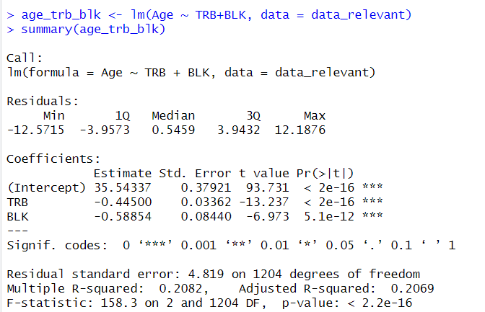
Summary Statistics for the Research Question
This statistics allows us to understand the BLK and TRB influence on Age.
P-values for these coefficients are low which specifies the corresponding variable is a significant predictor of Age.
R-squared value is higher and can be said that it is better fit of the model to the data

Slide 16
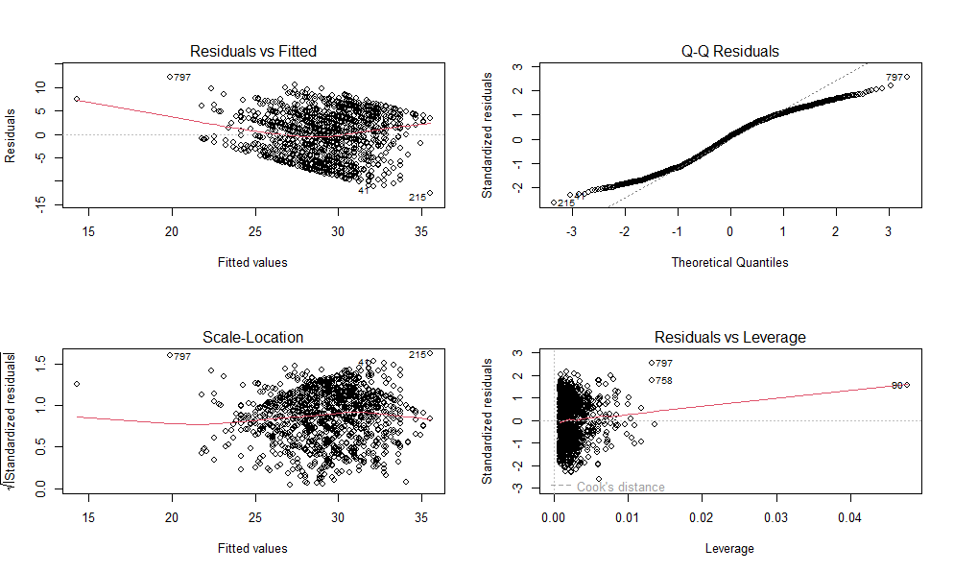
Co-relation between the data
Residual vs Fitted detects the non-linearity of the data.
Normal-QQ checks if residuals are normally distributed.
Scale-Location analyses the spread more clearly than Residual vs Fitted model.
Residual vs Leverage detects the disproportionate impact on the model.

Slide 17
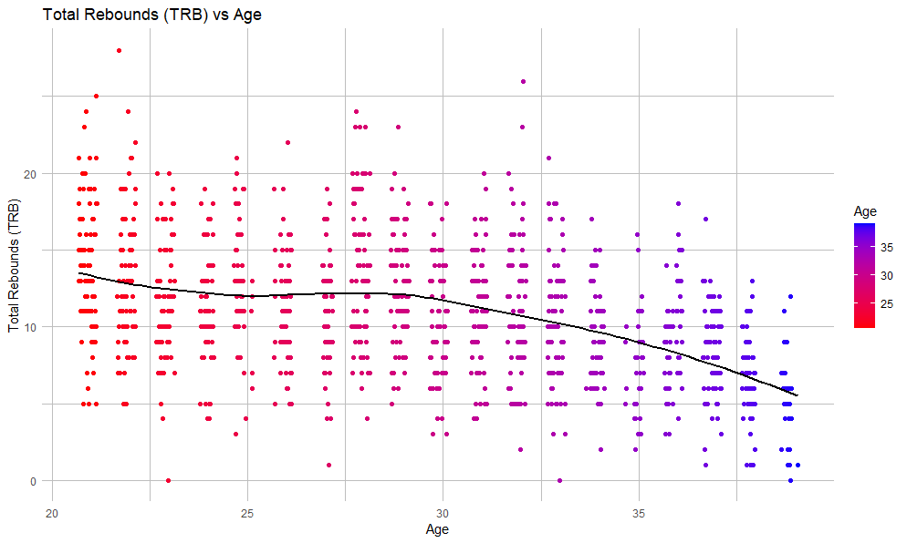
Exploratory visualizations and research questions
Visualisation between the Total rebounds and Age.
Age has affected the number of rebounds.
Loess can fit well with non-linear and complex model.

Slide 18
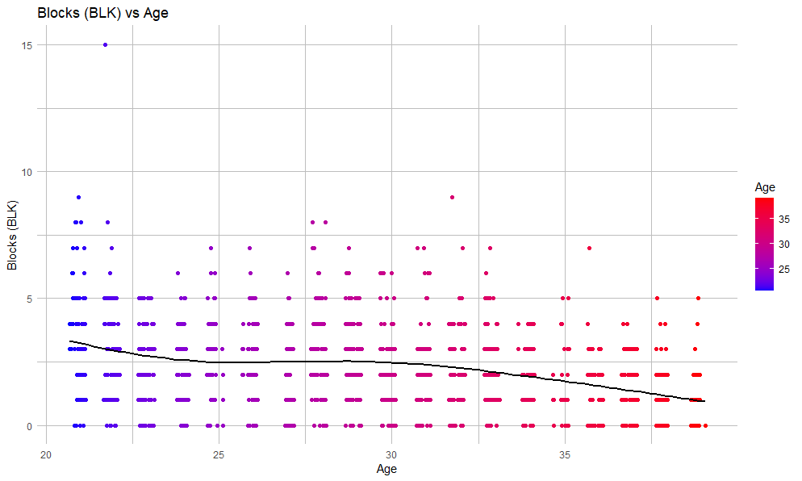
The Relation between Blocks and Age.
The trend line's movement provides insights into how block performance has varied over the years.
Age is also affected over here.

Slide 19
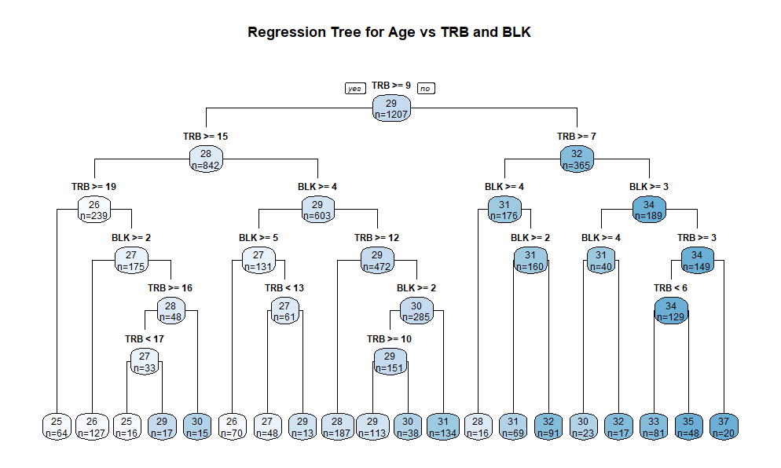
Regression tree model
The regression tree provides a visual and interpretable model of how TRB and BLK relate to Age.
The regression tree can capture complex, non-linear relationships that might not be apparent in a standard linear regression model.
The tree allows for making predictions at different levels of TRB and BLK.

Slide 20
(Initial)Results
Linear Regression:
A linear regression model has been created using Age as the response variable and both TRB and BLK as predictors. The summary of this model would provide the Co-efficients (35.54337), significance levels (p-values) (22 x 10⁻¹⁶), and model fit statistics(158.3).
Regression tree Model:
A regression tree trb_blk_tree_model has been fitted using Age as the response variable and TRB and BLK as predictors with a complexity parameter of cp=0.001. This suggests an attempt to balance the model's complexity and fit.
Regression analysis:
The R² value for the regression model between TRB and Age would be 0.1603, for BLK and Age would be 0.0813, the MSE value for TRB is 24.7301, and for the BLK is 27.0953

Slide 21
Conclusion
The analysis revealed that Total Rebounds and Blocks are important metrics that, according to the constructed models, vary with Shaquille O'Neal's age. The visualizations and models suggest that peak performance in these areas could be associated with specific age ranges.
The regression models and the regression tree provides insights into the statistical significance of the predictors and the fit of the models.

Slide 22
Research Question
#3:
How are the personal fouls and the offensive rebounds affecting Shaquille O’Neal’s points?

Slide 23
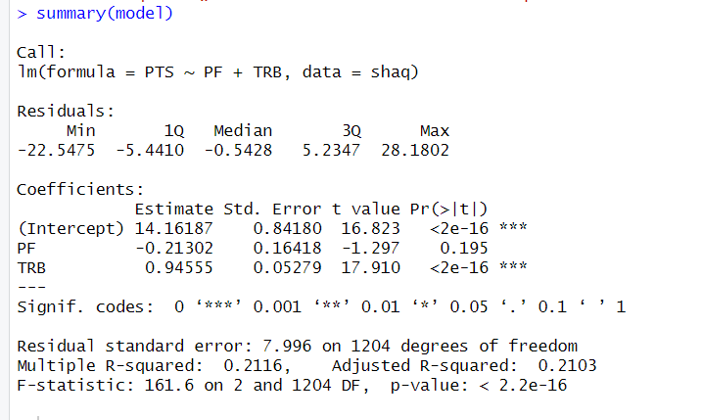
Summary statistics using Linear regression model.
The result of the linear regression model is that the residual standard error is 7.996 on 1204 degrees of freedom. This means that the model is able to explain 21.16% of the variation in the data, and that the average residual is 7.996.
The p-values for the PF and TRB variables are both less than 0.05, which means that these variables have a significant effect on the outcome of the model.

Slide 24
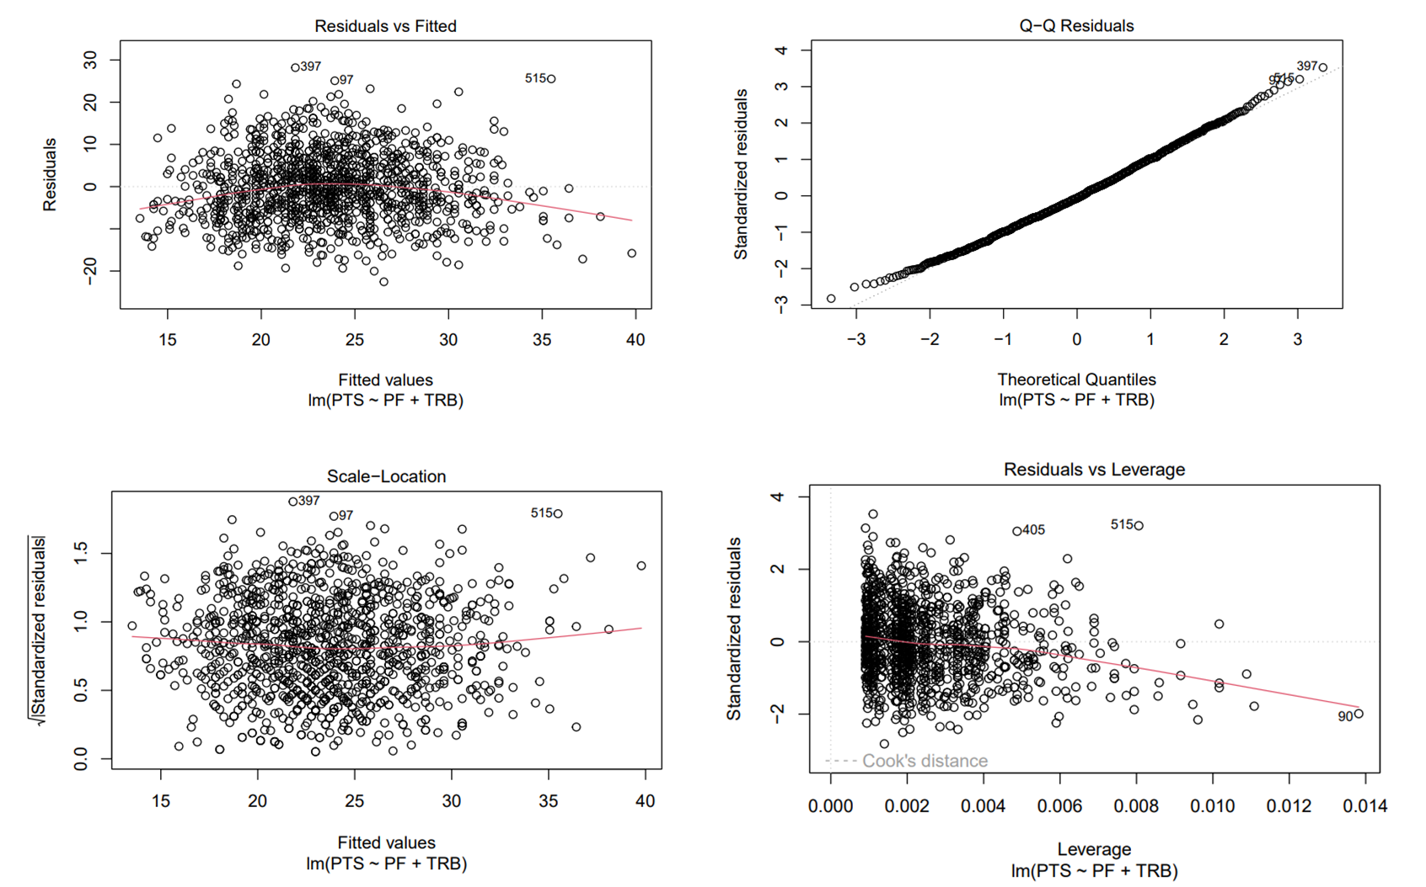
Data Visualization of the research question using linear regression.
Residual vs Fitted helps spot non-linear patterns in the data.
QQ checks if residuals follow a normal distribution.
Scale-Location shows spread more clearly than Residual vs Fitted.
Residual vs Leverage identifies points disproportionately impacting the model.

Slide 25
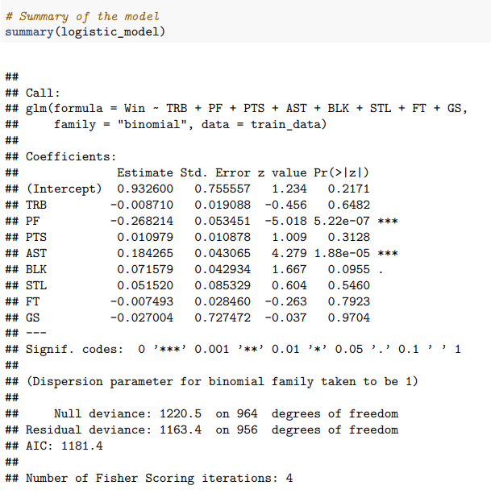
Summary statistics using Logistic regression.
This is a summary statistics of logisitic regression model which shows the significance of personal fouls and offensive rebounds on points. Here we used the formula “Win ~ Personal Fouls + Offensive Rebound and more variables”. After performing the regression analysis, we found out the pvalue and the required values for our regression model. Use of more variables increases the accuracy.

Slide 26
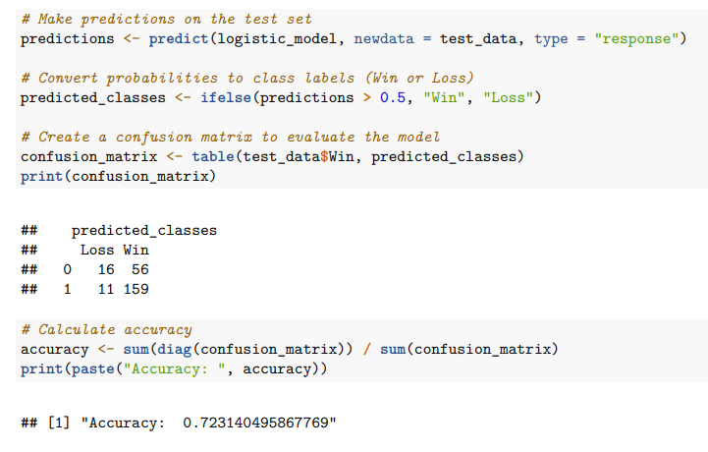
Predicting Win-Loss using logistic regression model.
The model was trained on a training dataset and then used to make predictions on the test dataset. The accuracy of the model was then calculated using a confusion matrix.
The confusion matrix shows that the model correctly predicted 56 out of 76 wins and correctly predicted 159 out of 214 losses. This gives an overall accuracy of 0.72, which means that the model correctly predicted the outcome of 72% of the test cases.

Slide 27
(Initial) results
Linear Regression Model:
A linear regression model was fitted to predict 'Win' using points (PTS), total rebounds (TRB), and personal fouls (PF) as predictors.
The variable total rebounds (TRB), personal fouls (PF) are significant variables and this model fits well. This model can be used to predict the dependent variable.
Logistic Regression Model:
A logistic regression model was fitted to predict 'Win' using points (PTS), total rebounds (TRB), assists (AST), blocks (BLK), personal fouls(PF), Steals(STL), GameScore(GS), and Free Throw(FT) as predictors.
The variables have a great influence on the results. The variables increases the accuracy of the logistic regression model.

Slide 28
Conclusion
#3: How are the personal fouls and the offensive rebounds affecting Shaquille O’Neal’s points?
Linear Regression Model:
Variables such as TRB, PF are key predictor variables.
This model is able to explain 21% variance, and has very less accuracy.
Logistic Regression Model:
Multiple Variables increases the accuracy of the model.
Win - Loss can be predicted using this model.

Slide 29
Challenges / further analysis
Additional Data Exploration:
Exploring more features or collecting additional data could provide further insights.
Analyzing player or team-specific trends could also be beneficial.
Comparison with Other Models:
Comparing these models with other statistical or machine learning techniques could provide a better understanding of their strengths and weaknesses.

